Slide 1

Molecular Structure and Color
Learning Outcomes:
The red, green, and blue colors in a smartphone display are due to different dyes
The chemical structure of the dye is responsible for the color you see
The chemical structure of the dye is responsible for the energy of light you see
This material was developed as part of a grant received from the National Science Foundation, Award Number 1905734

Slide 2
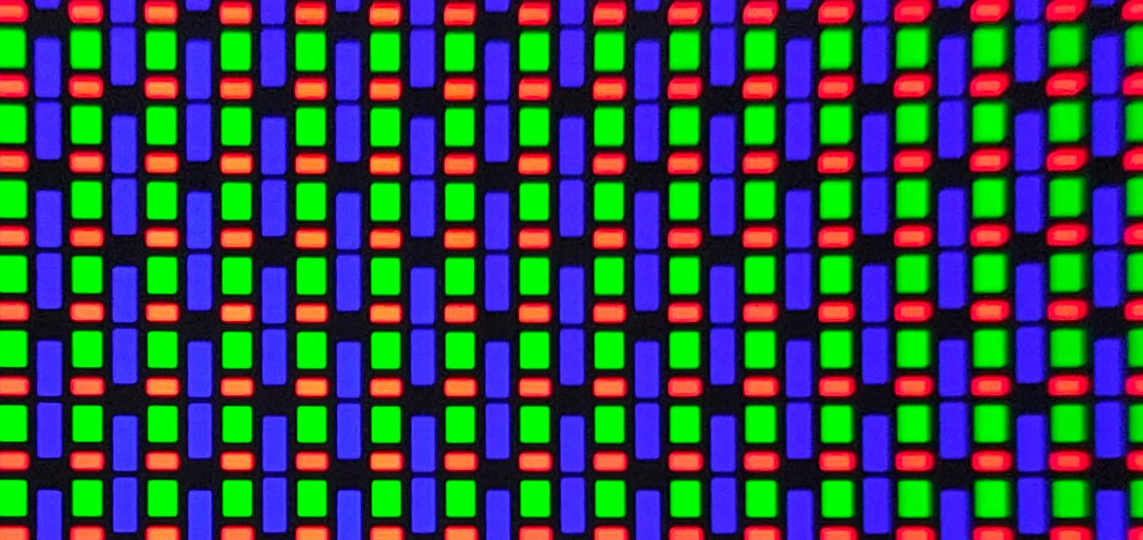
How is the color determined in an OLED display?
Molecules in an OLED emit light when an electric current passes through them.

Slide 3
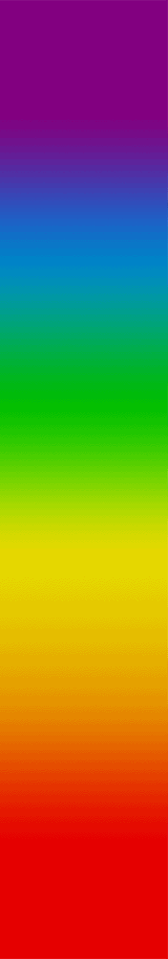
Molecular structure!
The chemical structure changes the color of light we perceive.​
Small changes in chemistry can lead to big changes in color.​
Computational chemists can predict color based on the molecular structure.​
Energy

Slide 4
Let’s predict color
Which molecule will have the color with the largest energy (i.e., most blue color)?
If you wanted to make a molecule more red in color, what changes could you make?
Estimate how many double bonds are needed for violet (400 nm or 3.1 eV).
Color and Molecular Structure Module:
https://github.com/megan-r-brown/Exploring-the-role-of-Materials-Chemistry-Biology-and-Electronics-in-Smartphones/tree/main

